Slide 1
ELECTION DATA VISUALIZATION

Slide 2
MEAN
CODERS
AKSHAY JAISWAL
JANHAVI DAHIHANDE
PRAJWAL VENKATESH
PRIYAL AGRAWAL

Slide 3









ELECTIONS
The backbone of democracy

Slide 4
IMPORTANCE OF ELECTIONS
BACKBONE OF DEMOCRACY
Election is crucial to activating the democratic process.
Elections give people an opportunity to have their say.
Elections give power back to the people.

Slide 5
The ballot is stronger than the bullet.
- Abraham Lincoln

Slide 6







SOME FACTS
The truth behind the curtains

Slide 7
IN 2016 California
79.77%
Voter Registration Rate
58.40%
Total voter turnout
11.56%
Voters with disability were deterred from voting

Slide 8








ANALYSIS
The need and possibilities

Slide 9
SOLVING PROBLEMS THROUGH DATA
One of the biggest problems faced by US elections is the voter turnout.
Low turnouts can lead to unequal representation among various parts of the population.
This is one of the biggest threat to the elections and democracy itself.
These problems are difficult to identify and solve without proper tools and data.
So we wanted to come up with a tool that can visualize this election data and help understand the problems better and solve them efficiently.

Slide 10

DATASETS

Slide 11
DATASET DETAILS
MIT Election Data + Science Lab
The MIT Election Data and Science Lab is dedicated to the nonpartisan application of scientific principles to election research and administration.
They have data from 2008 to 2016.
Dataset contains 17 different performance indicators for each state

Slide 12

CLIENTS

Slide 13
CLIENTS FOR THIS APPLICATION
TWO MAIN CLIENTS FOR THIS APPLICATION
Federal election committee/ Government officials
Geo-Political/history students/professor

Slide 14
DECISIONS PROMPTED BY THIS APPLICATION
Make proper arrangements for voters with disability.
Make the election process smoother like decreasing the wait time for voters.
Data completeness- Helps to improve the ways/methods we can collect the data.
Voter Turnout - Steps to be taken to encourage people to exercise voting especially young people.
State comparison- compare states, make decisions such as if a state is performing good, follow the strategies or methods adopted by the good performing state to improve the performance in the under performing states.

Slide 15

TECHNOLOGIES USED

Slide 16
TECHNOLOGIES USED
Mongo DB
Express
React
Node.js
React google charts
Fusion Charts

Slide 17

APPLICATION

Slide 18
APPLICATION
DASHBOARDS
National average dashboard
State level details dashboard
States comparison graph

Slide 19
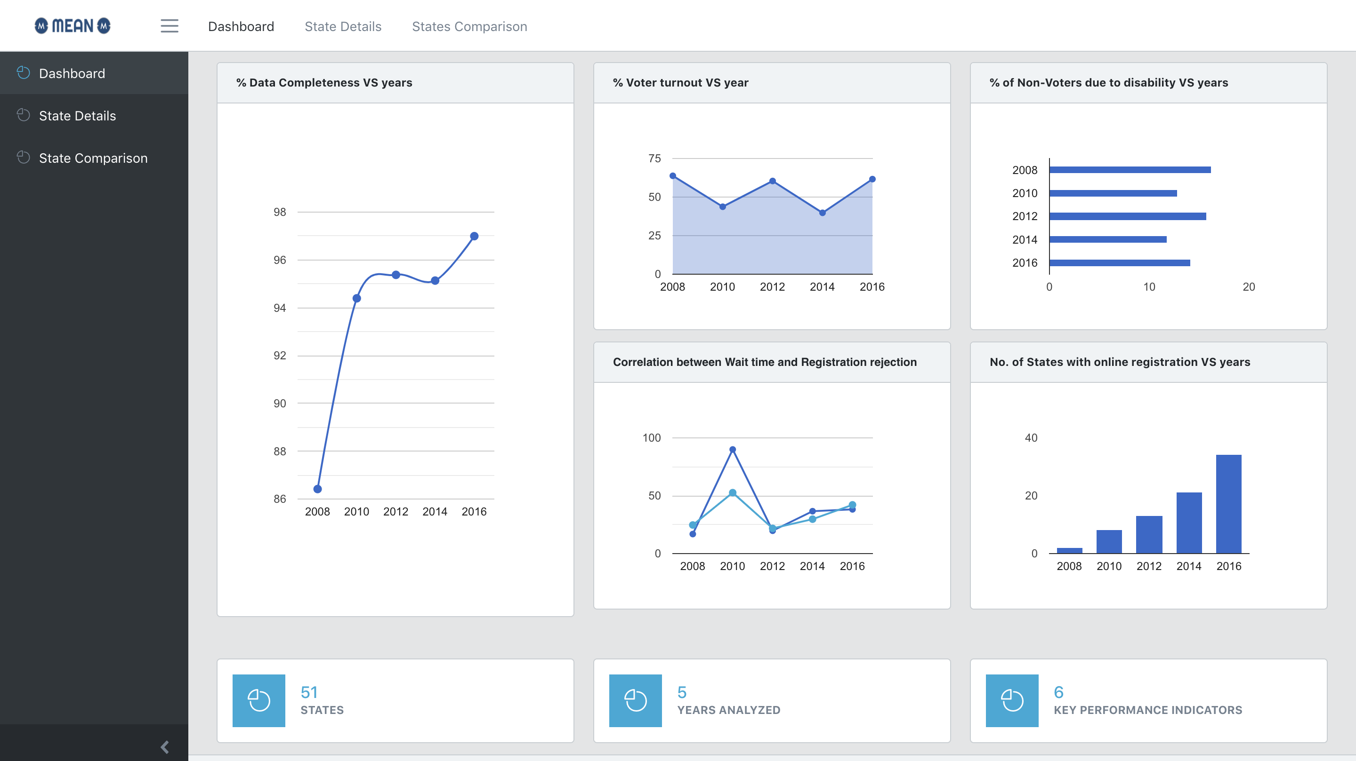
NATIONAL
AVERAGE
DASHBOARD

Slide 20
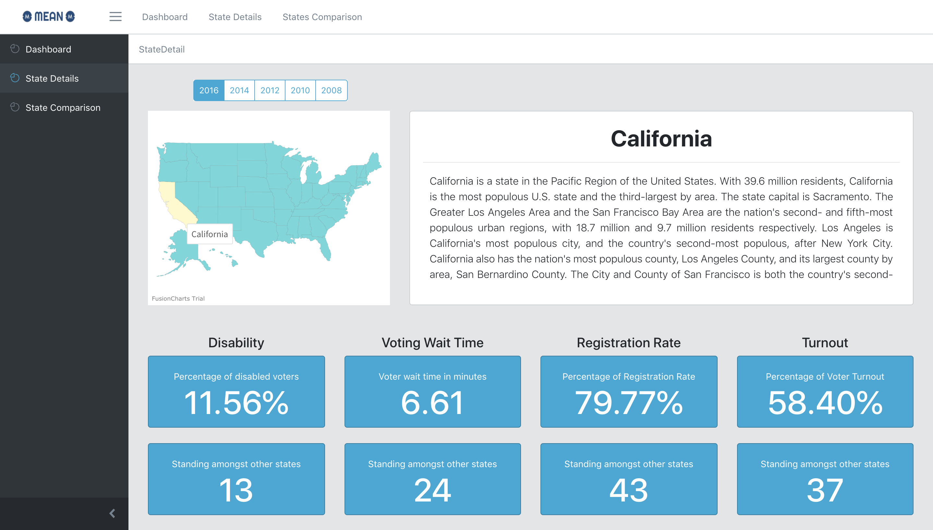
STATE
DETAILS
DASHBOARD

Slide 21
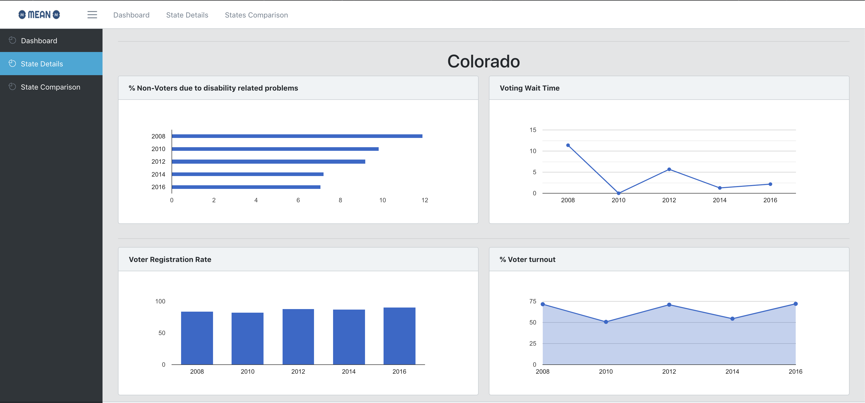
STATE
DETAILS
DASHBOARD

Slide 22
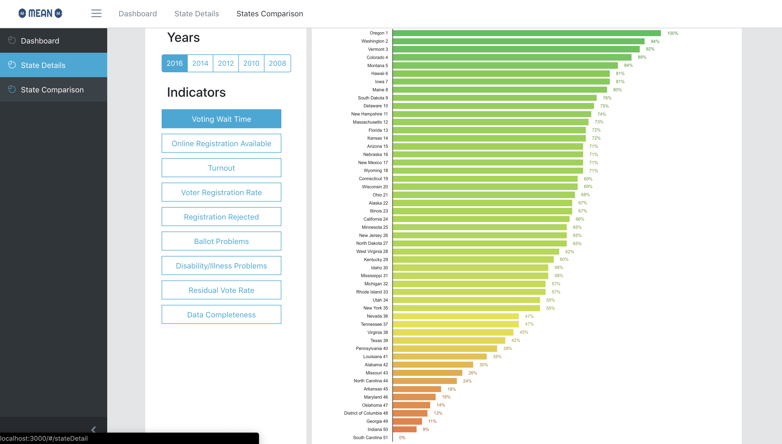
STATE
COMPARISON
GRAPH

Slide 23
KEY PERFORMANCE INDICATORS
SIX KEY PERFORMANCE INDICATORS (KPI’s)
Data Completeness
Voter turnout
Disability or illness related Voting problems
Wait time
Registration rejection
States with online registration

Slide 24
CAHRT DESIGN PRINCIPLES

Slide 25
CHART DESIGN PRINCIPLES
Use of familiar chart types
Bar charts should start at zero
Don’t include a legend when it’s not needed
Avoid 3D charts
Do not use randomly generated colors
Avoid mixing chart types
Order the data series

Slide 26
DASHBOARD DESIGN PRINCIPLES

Slide 27
DASHBOARD DESIGN PRINCIPLES
Relevant context of the data
Avoidance of excessive detail or precision
Proper arrangement of data
Remove Unnecessary grid lines in graphs

Slide 28
NEXT
DEMO

Slide 29
THANKS!
ANY QUESTIONS?

